Slide 1
SSWT ZG526 DISTRIBUTED COMPUTING Dr. SRINIVASA KOSIGANTI srinikosi@wilp.bits-pilani.ac.in
`

Slide 2

IMP Note to Self
START RECORDING

Slide 3
Contact Session – 2
Logical Clocks & Vector Clocks
[T1: Chap - 3]

Slide 4
IMP Note to Students
It is important to know that just login to the session does not guarantee the attendance.
Once you join the session, continue till the end to consider you as present in the class.
IMPORTANTLY, you need to make the class more interactive by responding to Professors queries in the session.
Whenever Professor calls your number / name ,you need to respond, otherwise it will be considered as ABSENT

Slide 5
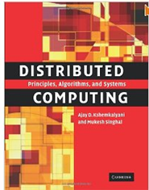
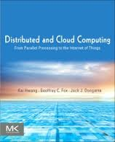
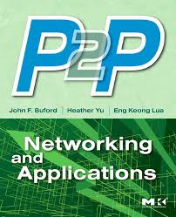
Text and References
T1 | Ajay D. Kshemkalyani, and Mukesh Singhal “Distributed Computing: Principles, Algorithms, and Systems”, Cambridge University Press, 2008 (Reprint 2013).
R1 | Kai Hwang, Geoffrey C. Fox, and Jack J. Dongarra, “Distributed and Cloud Computing: From Parallel processing to the Internet of Things”, Morgan Kaufmann, 2012 Elsevier Inc.
R2 | John F. Buford, Heather Yu, and Eng K. Lua, “P2P Networking and Applications”, Morgan Kaufmann, 2009 Elsevier Inc.

Slide 6
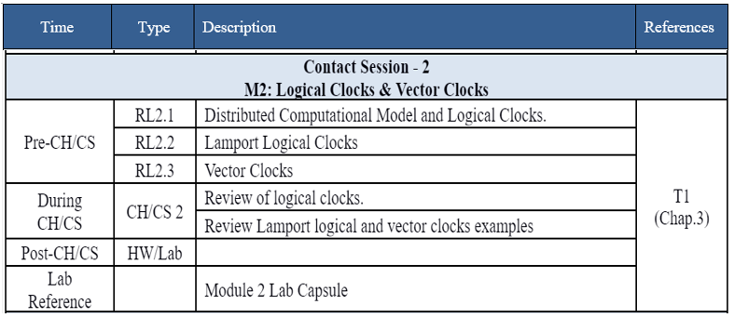
Module Details

Slide 7
Presentation Overview
Logical Time Introduction
Implementing Logical Clocks
Scalar Time
Lamport Timestamps
Vector Time
Vector Clocks
Rules For Vector Clocks Updates
Matrix Clock
Physical Clock Synchronization: NTP

Slide 8
LOGICAL TIME INTRODUCTION
The concept of causality between events is fundamental to the design and analysis of parallel and distributed computing and operating systems.
Usually, causality is tracked using physical time.
In distributed systems, it is not possible to have global physical time; it is possible to realize only an approximation of it.
Causality among events in a distributed system is a powerful concept in reasoning, analyzing, and drawing inferences about a computation.

Slide 9
LOGICAL TIME WITH CAUSE-AND-EFFECT RELATIONSHIP
CONCEPT/ISSUE | TECHNICAL DESCRIPTION | NON-TECHNICAL DESCRIPTION | TECHNICAL EXAMPLE | NON-TECHNICAL EXAMPLE
CAUSALITY IN DISTRIBUTED COMPUTING | Understanding how events influence one another (cause-and-effect) in a system where components operate independently and without synchronized time. | Figuring out the domino effect of actions in a network, like how one roadblock can affect traffic flow in an entire city. | Ensuring updates in a distributed database occur in the right order to maintain data consistency. | Determining how a change in a supplier’s delivery schedule impacts the entire production line.
LOGICAL TIME | Logical time systems (like Lamport timestamps, vector clocks) order events in distributed systems without relying on synchronized physical clocks. | A system of tracking the sequence of events, like a unique stamp on emails, independent of actual time. | Using Lamport timestamps to order messages in a distributed chat application. | Organizing a series of team emails by the order in which they were sent, not the time.
DISTRIBUTED ALGORITHMIC DESIGN | Designing algorithms that factor in the independent and potentially concurrent operations across different system nodes. | Creating rules or procedures for tasks that are carried out by multiple agents independently. | Developing a mutual exclusion algorithm for managing access to a shared resource in a network. | Coordinating a large-scale event where various teams work independently on different tasks.
TRACKING OF DIFFERENT EVENTS | Monitoring and managing events and their dependencies in a distributed system to maintain system integrity and perform debugging. | Keeping track of a series of related actions or occurrences, like updates in a project timeline. | Implementing a system to track data modifications across multiple servers for debugging. | Keeping a log of who added or changed information in a shared online document.
KNOWLEDGE ABOUT THE PROGRESS | Assessing the advancement and state of processes in a distributed system, useful for optimization like garbage collection or termination detection. | Understanding how far along a series of interconnected activities is, like progress in a relay race. | Using vector clocks to determine if certain computations in a distributed system have become obsolete. | Assessing the progress of a multi-stage school project where different students’ complete parts independently.

Slide 10
IMPLEMENTATION OF LOGICAL CLOCKS – A STEP-BY-STEP APPROACH WITH EXAMPLES
ASPECT | TECHNICAL DESCRIPTION | NON-TECHNICAL DESCRIPTION | TECHNICAL EXAMPLE | NON-TECHNICAL EXAMPLE
IMPLEMENTATION OF LOGICAL CLOCK | Each node in a distributed system maintains a local logical clock, incrementing it with each local event and adjusting it based on received messages. | Imagine each participant in a group project has their own stopwatch, which they use to timestamp their updates. | In a distributed database, each node timestamps data modifications with its local clock. | In a team project, each member timestamps their contributions when they add to the project.
PARTIAL ORDERING OF EVENTS | Logical clocks allow for the partial ordering of events based on causality, not a total chronological order. Organizing a sequence of actions based on their logical sequence rather than the time they occurred. | It's like sequencing actions based on their impact on subsequent actions, rather than when they happened. Logical clocks in a distributed system order events based on cause and effect, not by real-time. | During a live-streamed cricket match, different cameras capture moments (like a catch or a run) and these clips are sequenced to create a coherent narrative of the match. | Organizing a cricket training session where the sequence of exercises (warm-up, skill drills, practice matches) is based on their training effectiveness, not the time they are initiated.
STEP 1: EVENT OCCURRENCE | Each node increments its logical clock for every event (e.g., sending/receiving a message). | Each group member marks their progress every time they complete a part of their task. | In cricket, each ball bowled is an event. Every ball increments the 'over' count, like a logical clock. | Each bowler records the number of balls they've bowled in their spell, akin to maintaining a personal log of overs.
STEP 2: SENDING MESSAGES | When a node sends a message, it includes its current logical clock value. | When a team member sends an update, they include the time from their stopwatch. | In a cricket match, every ball bowled is recorded with its exact time, like a ball bowled at 3:05 PM. This timestamp is crucial for match records, statistics, and analysis. | A cricket team captain sends a message to team members about the time they plan to start the team's batting practice, e.g., "We'll start batting practice at 10 AM."
STEP 3: RECEIVING MESSAGES | Upon receiving a message, a node updates its clock to reflect the received information and its own state. | On receiving an update, team members adjust their understanding of the project timeline. | In a live cricket scoring system, when the scoring node receives updated information about a recent boundary, it adjusts its score record to reflect this latest event. | A cricket coach adjusts the team's training schedule based on a message from a player who will arrive late, ensuring the training activities align with the player's arrival.

Slide 11
Thank You

Slide 12

IMP Note to Self
STOP RECORDING

